Slide 1



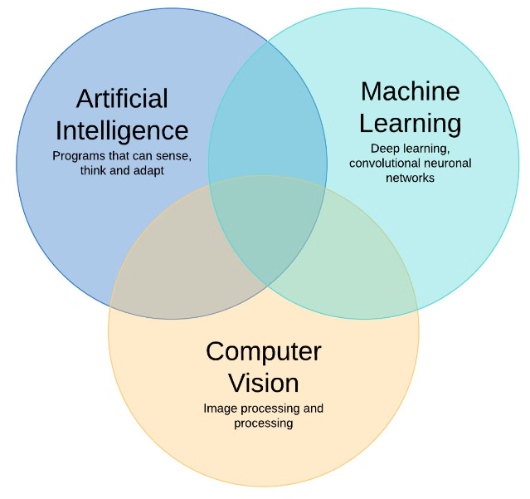
Gender and Age Detection using Machine Learning

Slide 2
A Summer Project by
MEET GHELANI (ET21BTAI17)
KRUPANSH NAKRANI (ET21BTAI45)
KEYUR PATEL (ET21BTAI52)
PRESHTHA BODAR (ET22BTAI802)

Slide 3

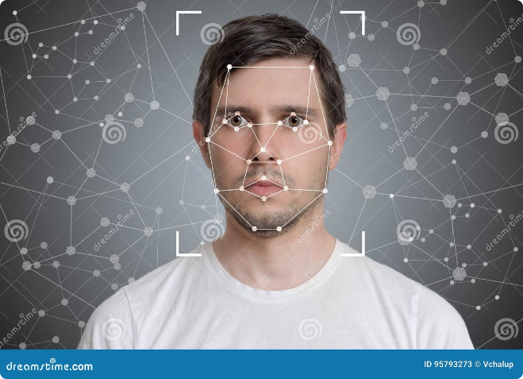
Introduction to Gender and Age Detection
What is Gender and Age Detection?
Gender and age detection is the process of using machine learning and computer vision techniques to analyze visual data, such as images or videos, and determine an individual's gender and approximate age.
Importance of the Project
This technology has significant applications in fields like marketing, security, and customer service, where understanding the demographics of the target audience or user base is crucial for optimizing strategies and enhancing user experiences.
Project Objective
The primary goal of this project is to develop a robust and accurate tool that can reliably detect gender and age from visual inputs,

Slide 4
Technological Foundations
Artificial Intelligence and Computer Vision
Deep Learning Models
For face detection: OpenCV Face Detector Model
This project leverages the power of artificial intelligence and computer vision, enabling machines to understand and interpret visual data with human-like precision and accuracy.
For Age detection : Caffe Age Detection Model(A pre-trained Caffe model for predicting age ranges)
For gender detection: Caffe Gender Detection Model(A pre-trained Caffe model for predicting gender)

Slide 5
Libraries and Models Utilized in the Project
OpenCV (Open Source Computer Vision Library):
It is an open-source library used for computer vision tasks such as image and video processing.
Open-CV Provides functions for image manipulation, face detection, and working with deep learning models.
Key Functions:
cv.dnn.readNet: Loads pre-trained deep learning models.
cv.dnn.blobFromImage: Converts images to blobs for model input.
cv.rectangle: Draws bounding boxes around detected objects.
2.Streamlit:
Streamlit is an open-source Python library for creating and sharing beautiful, custom web apps for machine learning and data science.
It allows data scientists and machine learning practitioners to build interactive web applications quickly and easily without needing front-end development skills.

Slide 6
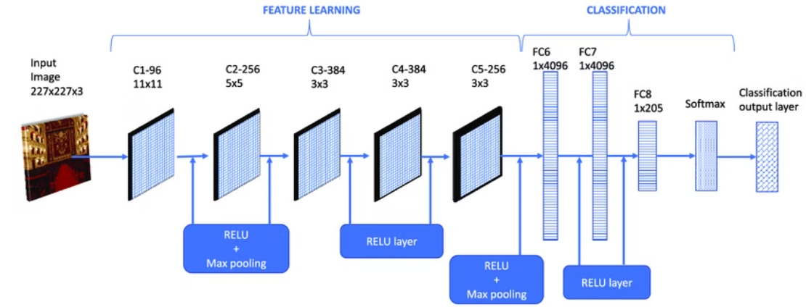
Model:
CNN places architecture design based on the pre-trained 'Caffe' model .
Caffe: Caffe is a deep learning framework developed by the Berkeley Vision and Learning Center (BVLC). It is known for its speed, modularity, and ease of use, particularly in training and deploying deep learning models.
Key Features:
Performance: Optimized for speed and efficiency, making it suitable for large-scale image processing tasks.
Modularity: Supports various types of neural network layers and architectures.
Ease of Use: Provides a straightforward interface for training models and running inferences.

Slide 7
Project Workflow
Gender and Age Detection
Input Acquisition
The model outputs a probability distribution over the classes (male, female, and age ranges). The gender and age with the highest probability are chosen as the final predictions.
Output Display and Storage
ImageInput: The system starts by acquiring input, which can be an image file or live webcam stream.
The final output image or video frame, with labeled bounding boxes, is displayed to the user.
1
2
3
4
5
Face Detection
Post-processing
Pre-processing: The input image or video frame is pre-processed to create a blob suitable for the deep learning model.
Labeling
The predicted gender and age range are combined to create a label. This label is then superimposed on the original input image or video frame at the location of the detected face.

Slide 8
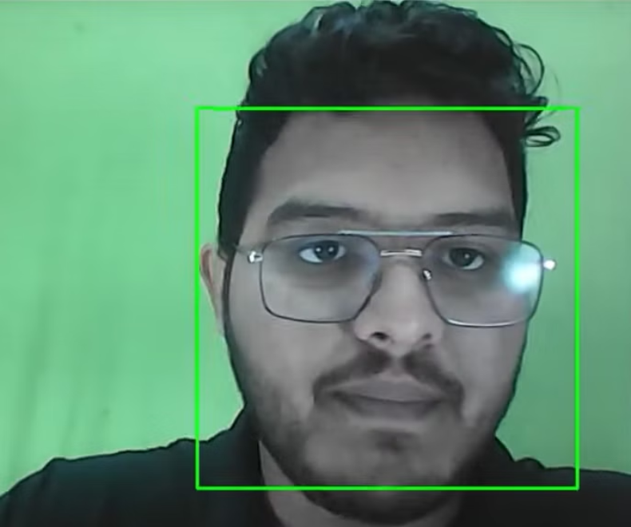
Face Detection
Pre-processing:Convert the input image to a blob, which is a 4-D array used by the deep learning model.
Model Utilization:Load the pre-trained face detection model (opencv_face_detector) Feed the blob into the model to detect faces.
Post-processing:The model outputs bounding boxes around detected faces. Draw bounding boxes on the original image to highlight detected faces.

Slide 9
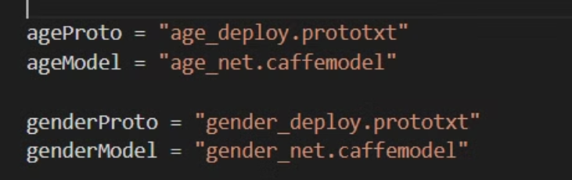
Age and Gender Detection
Gender Detection:Load the pre-trained gender detection model (gender_net).Feed the face blob into the gender detection model.Predict the gender based on the model’s output.
Pre-trained models:
Age Detection:Load the pre-trained age detection model (age_net).Feed the face blob into the age detection model.Predict the age range based on the model’s output.

Slide 10
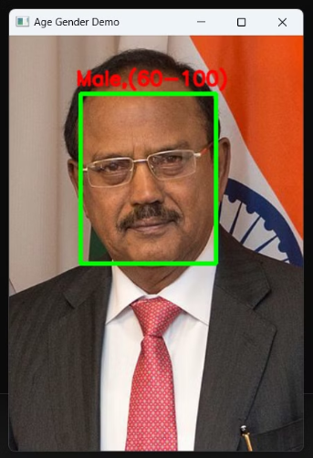
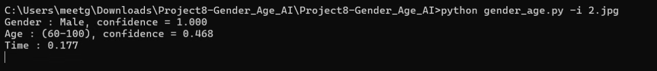
Outputs:

Slide 11
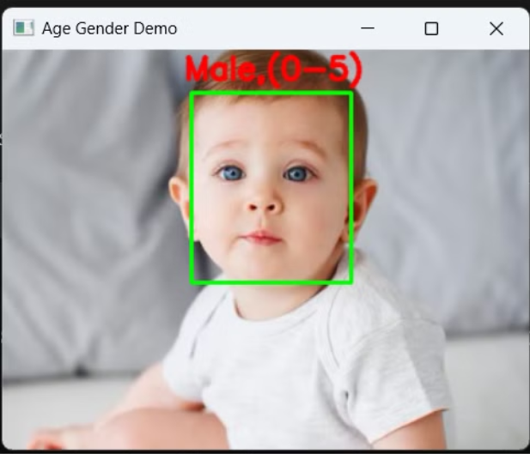

Slide 12
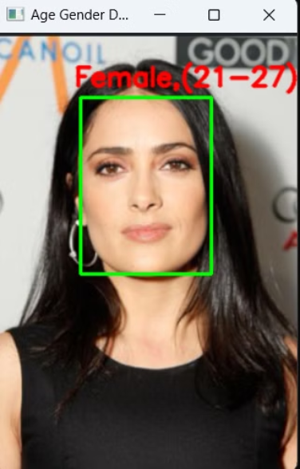

Slide 13



Challenges and Future Work
Accuracy and Precision:
Future Improvements
Challenge: Achieving high accuracy in age and gender prediction can be difficult, especially with diverse and varying quality images.
Handling Diverse Inputs:
Objective: Improve the model’s ability to handle a wide range of face images, including those with varying expressions, lighting, and angles.
The models might struggle with images of low resolution or poor lighting conditions, leading to incorrect predictions.
Approach: Train or fine-tune models on datasets that include a broader variety of conditions and face types.

Slide 14

References and Credits
We would like to acknowledge the following resources and libraries that were instrumental in the development of our project:
Caffe Model Images
CNN Places Architecture Design(image)
OpenCV Library
Streamlit Documentation

Slide 15


Thank You
We hope this presentation has provided you with a comprehensive overview of our project on gender and age detection using artificial intelligence. We are excited to continue exploring the possibilities and potential of this transformative technology. Thank you for your time and attention.

